Slide 1


Lucas Favaro
August 2025

Slide 2
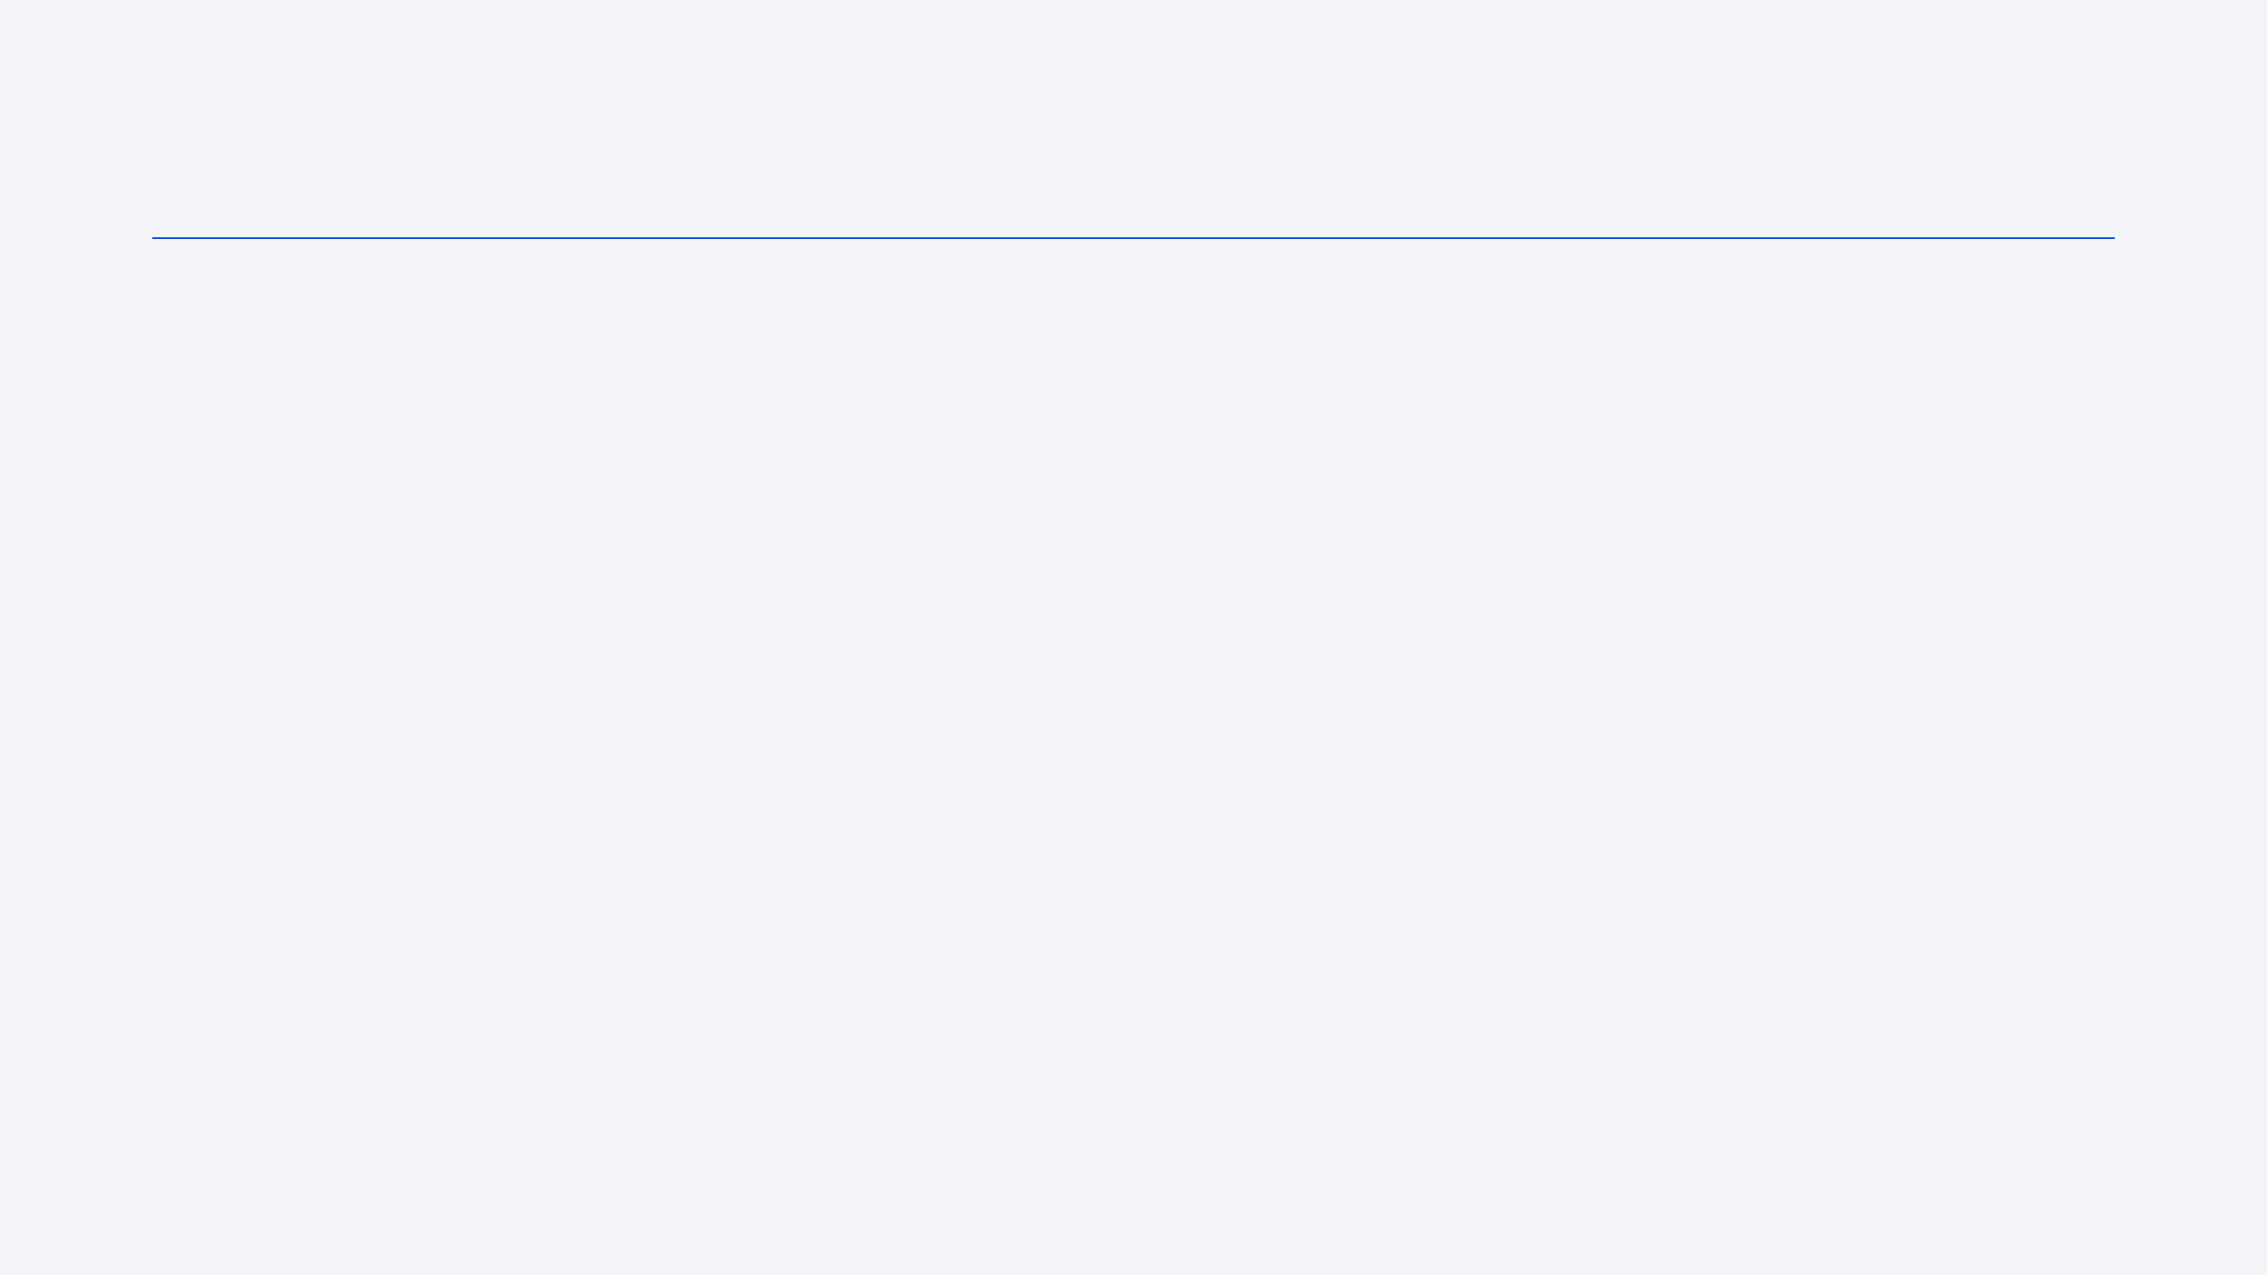
Outline
Executive Summary
Introduction
Methodology
Results
Conclusion

Slide 3
Executive Summary
Summary of Methodologies:
Data were collected via API and web scraping from SpaceX and Wikipedia.
Data wrangling, SQL queries, and visualizations were used for EDA.
Interactive maps were built with Folium.
Multiple classification models (SVM, Logistic Regression, Decision Tree, KNN) were trained using cross-validation and hyperparameter tuning.
Summary of Results:
Success rates increased over time, with some orbits achieving 100% success.
SVM and Logistic Regression were the most accurate models (~83%).
Interactive maps revealed launch site patterns and geographic insights.

Slide 4
Introduction
Project background and context:
SpaceX has conducted numerous Falcon 9 launches with varying outcomes. Understanding the factors behind successful landings is essential for improving future missions. This project analyzes historical launch data to extract insights and build predictive models.
Some questions that are answered with this report:
What launch conditions are most associated with success?
Are certain orbits, payloads, or sites more likely to lead to successful landings?
Can we predict the success of a mission based on its features?

Slide 5

Section 1

Slide 6
Methodology
Executive Summary
Data collection methodology
Perform data wrangling
Perform exploratory data analysis (EDA) using visualization and SQL
Perform interactive visual analytics using Folium
Perform predictive analysis using classification models

Slide 7
Data Collection
The data sets were collected through two alternative process: API and web scraping.
First, it was created a request to the SpaceX API. In summary, the steps were the following:
It was fetched a static snapshot of past launches.
It was filtered e cleaned to single-core, single-payload flights.
It was used helper functions to call the SpaceX API for rockets, launchpads, payloads, and cores.
It was built a final pandas DataFrame combining original flight numbers/dates with the enriched fields.
Then, a web scraping was performed to collect Falcon 9 historical launch records from a Wikipedia page.

Slide 8
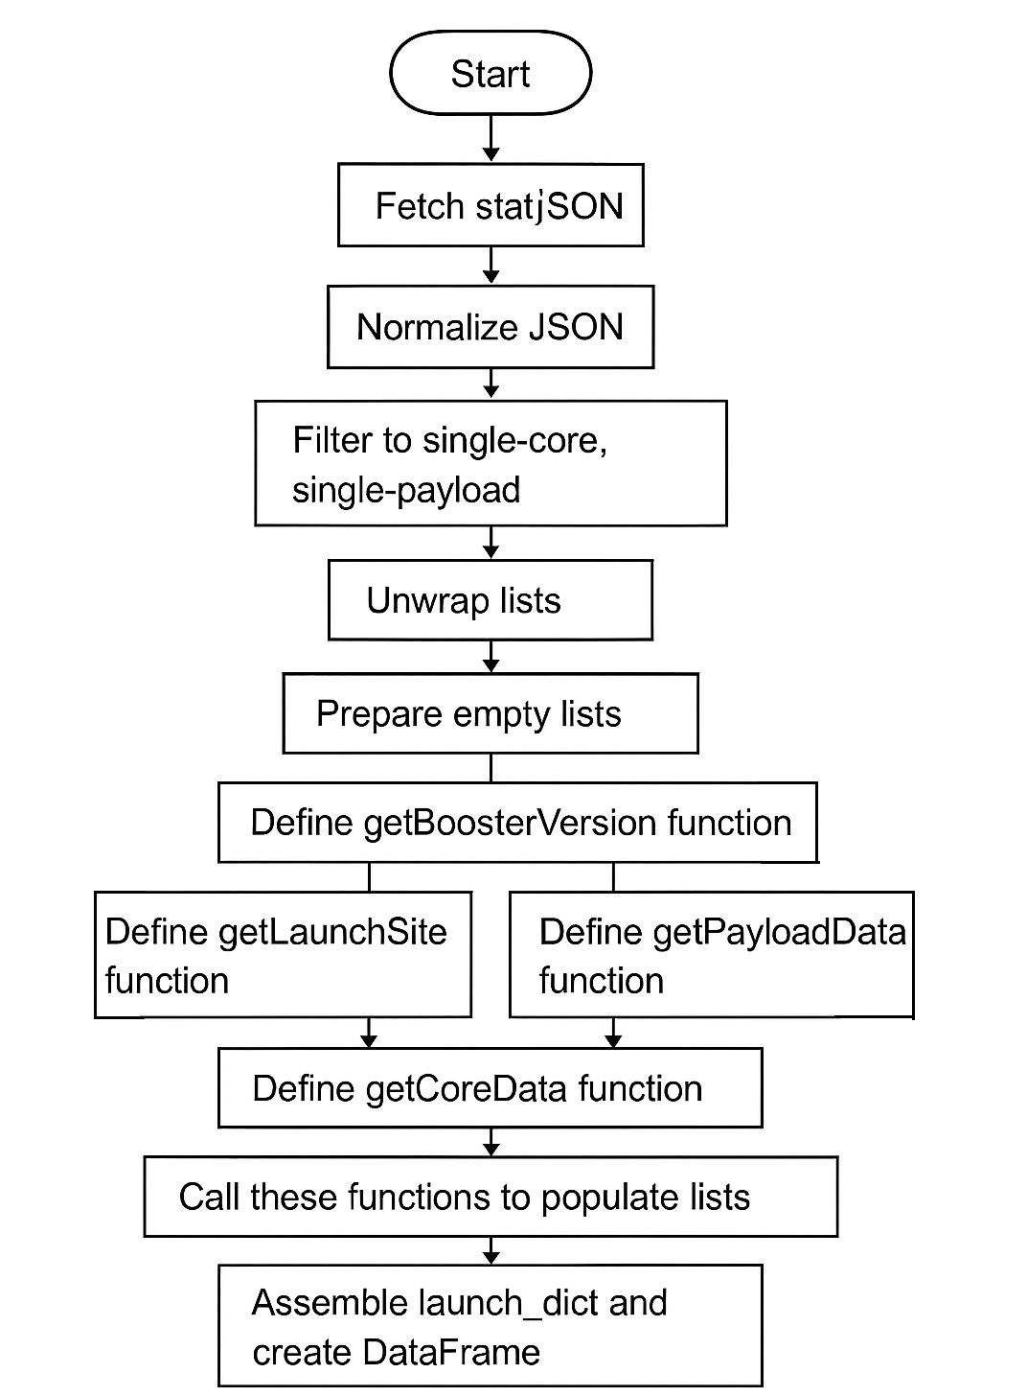
Data Collection – SpaceX API
The GitHub URL of the completed SpaceX API calls notebook is found here.

Slide 9
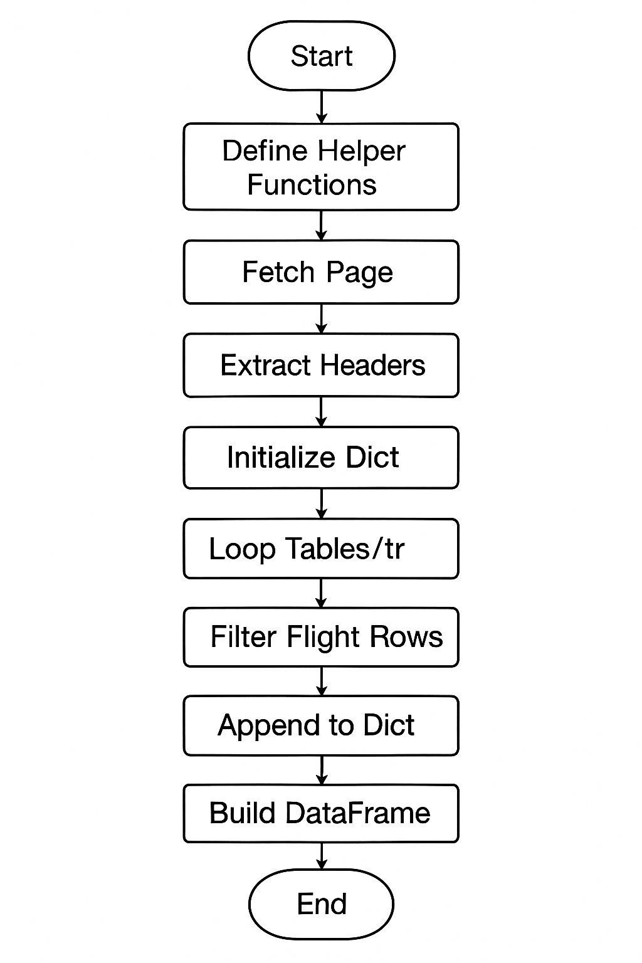
Data Collection - Scraping
The web scraping followed the following steps:
Helper functions parsed and cleaned individual cell contents.
It was fetched and parsed the specific Wikipedia page.
It was extracted and cleaned column headers, and initialized a dictionary of lists.
It was iterated through each relevant <tr> row, filtered only valid launch rows, and extracted each field via helper functions.
It was assembled all collected lists into a pandas DataFrame for further analysis.
The GitHub URL of the completed SpaceX web scraping notebook is found here.

Slide 10
Data Wrangling
It was performed some data wrangling to try and find patterns in the data. The main goal of this process was to calculate what is the landing success rate of the Falcon 9 rocket.
The steps were the following:
Data was imported from a CSV into a DataFrame.
Missing values and data types were inspected.
Launch site, orbit, and outcome values were explored.
Unsuccessful landing outcomes were defined.
A binary Class column was created to indicate success (1) or failure (0).
The overall landing success rate was calculated.
The GitHub URL of the data wrangling notebook is found here.

Slide 11
EDA with Data Visualization
Some exploratory Data Analysis and Feature Engineering were performed using Pandas and Matplotlib. The steps were the following:
Loaded data from a CSV into a DataFrame.
Explored missing values, data types, and key columns.
Visualized relationships between flight number, orbit, payload mass, launch site, and success (“Class”).
Extracted launch year and plotted success rate over time.
One-hot encoded categorical columns.
Converted data to numeric format for modeling.
The GitHub URL of the completed SpaceX data visualization notebook is found here.

Slide 12
EDA with SQL
Some exploratory Data Analysis were also performed via SQL. The steps were the following:
A cleaned table without NULL dates was created.
Sample rows and distinct values (launch sites, outcomes, booster versions) were retrieved.
Records were filtered by site prefix and payload mass range.
Aggregates were calculated: the average payload mass for “F9 v1.1” and the total NASA payload mass.
Data was grouped by outcome, and the earliest ground-pad success date was identified.
The GitHub URL of the completed SQL notebook is found here.

Slide 13
Build an Interactive Map with Folium
Some interactive maps were created with Folium through the following steps:
The SpaceX launches DataFrame was loaded and filtered to extract site coordinates and success flags.
A Folium map was initialized, centered on NASA’s Johnson Space Center.
One circle marker and text label were added for each unique launch site.
A MarkerCluster was created to display individual launch events, color-coded by success or failure.
The great-circle distance from a launch site to the nearest coastline was calculated.
A PolyLine was drawn between the site and the coast, and a permanent DivIcon label was placed to show the distance.
The GitHub URL of the completed SQL notebook is found here.

Slide 14
Predictive Analysis (Classification)
Models were built, evaluated, improved, and the best performing classification model was found. The steps were the following:
Four classifiers — Logistic Regression, SVM, Decision Tree and K-NN — were first created and wrapped in GridSearchCV to explore their key hyper-parameters with 10-fold (or 5-fold) cross-validation on the training set.
After fitting the grids, each model’s best cross-validated score was recorded and its accuracy was then re-checked on the held-out test set.
Final test accuracies ranked the models as SVM ≈ Logistic Regression (0.83) > Decision Tree (0.72) > K-NN (0.61).
The GitHub URL of the completed predictive analysis notebook is found here.

Slide 15
Results
Exploratory Data Analysis Results:
Success rates improved over time.
Some orbits had 100% success; SO had 0%.
No strong link between payload mass and success.
Interactive Analytics Demo: Maps showed launch sites, success clusters, and distances to coast.
Predictive Analysis Results:
SVM and Logistic Regression performed best (~83%).
Decision Tree overfit.
KNN underperformed.

Slide 16

Section 2

Slide 17
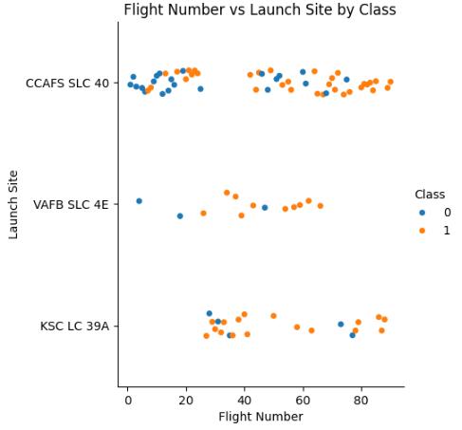
Flight Number vs. Launch Site
The image on the side shows the flight number plotted against the launch site, split up by class (0 = failure; 1 = success). As you can see, there are three launch sites.
There is a concentration in failed launchs at the left side of the x axis, which indicates that there is a learning-by-doing process in actions, that is: the more attempts were made, the more success was achieved.

Slide 18
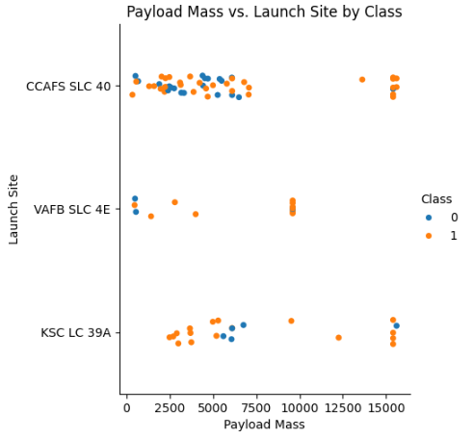
Payload vs. Launch Site
The image on the side shows the payload mass plotted against the launch site, split up by class again.
There are in general two types of payload: a light payload range (up to 7500 kg approx.) and a heavy payload range (above 15000 kg), with few observations in between.
There is no clear correlation between payload and class, at least not from this graph.

Slide 19
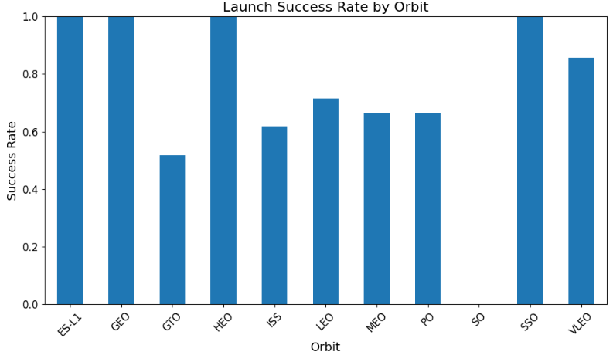
Success Rate vs. Orbit Type
The image on the side shows the launch success rate by orbit.
The orbits with the highest success rate are “ES-L1”, “GEO”, “HEO”, and “SSO”, with 100% success rate.
The orbit with the lowest success rate is “SO”, with 0% success rate.

Slide 20
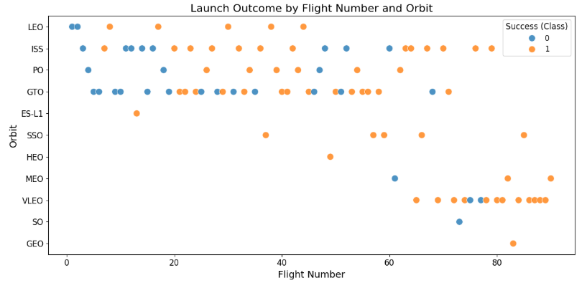
Flight Number vs. Orbit Type
The image on the side shows the launch outcome split up by flight number and orbit.
We can see that whereas orbits like “LEO”, “ISS” and “GTO” were tried since the beginning of the launchs, orbits like “MEO”, “SO”, and “GEO” were tried just after a lot of launchs having being done.

Slide 21
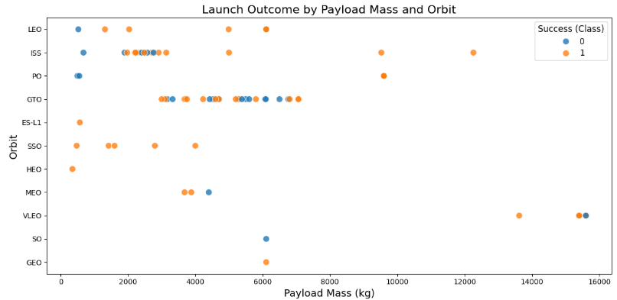
Payload vs. Orbit Type
The image on the side shows the launch outcome split up by payload mass and orbit.
Orbits like “LEO”, “ISS”, and “SSO” had a low payload mass, whereas the “VLEO” orbit had a high payload mass.

Slide 22
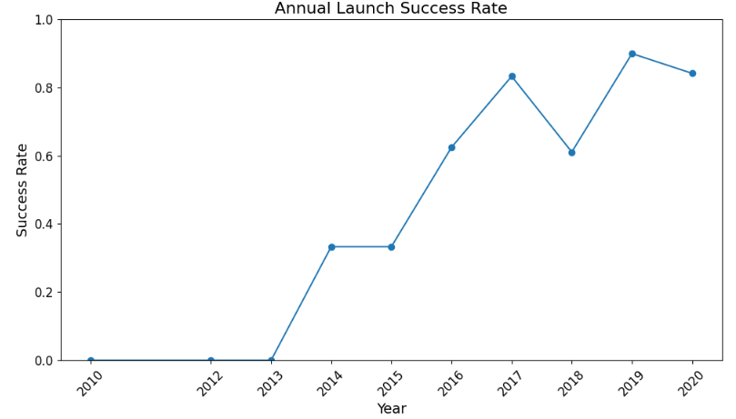
Launch Success Yearly Trend
The image on the side shows the annual launch success rate by year.
In the early years, the success rate was null, but from 2014 on the success rate increased, reaching approximately 90% in recent years.

Slide 23
All Launch Site Names
The names of the unique launch sites are:
CCAFS LC-40
VAFB SLC-4E
KSC LC-39A
CCAFS SLC-40
To obtain this result, it was queried from the SPACEXTABLE dataframe all the distinct cells in the “Launch_Site” column.

Slide 24
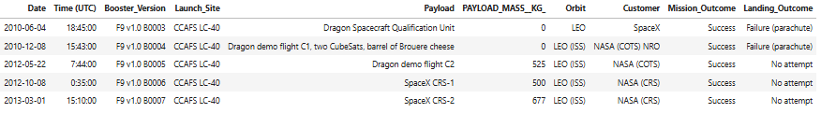
Launch Site Names Begin with 'CCA'
Below are a table with 5 records where launch sites begin with the string 'CCA’.
To obtain this result, it was queried from the SPACEXTABLE dataframe the first 5 results where “Launch_Site” started with 'CCA’.

Slide 25
Total Payload Mass
The total payload carried by boosters from NASA was 45,596 kg.
To obtain this result, it was queried from the SPACEXTABLE dataframe the sum of “PAYLOAD_MASS__KG_” column where “Customer” column was equal to 'NASA (CRS)’.

Slide 26
Average Payload Mass by F9 v1.1
The average payload mass carried by booster version F9 v1.1 was 2,928.4 kg.
To obtain this result, it was queried from the SPACEXTABLE dataframe the average of “PAYLOAD_MASS__KG_” column where “Booster_Version” column was equal to ‘F9 v1.1’.

Slide 27
First Successful Ground Landing Date
The date of the first successful landing outcome on ground pad was 2015-12-22.
To obtain this result, it was queried from the SPACEXTABLE dataframe the minimum value of the “Date” column where “Landing_Outcome” column was equal to ‘Success (ground pad)’.

Slide 28
Successful Drone Ship Landing with Payload between 4000 and 6000
The names of boosters which have successfully landed on drone ship and had payload mass greater than 4000 but less than 6000 are the following: F9 v1.1, F9 v1.1 B1011, F9 v1.1 B1014, F9 v1.1 B1016, F9 FT B1020, F9 FT B1022, F9 FT B1026, F9 FT B1030, F9 FT B1021.2, F9 FT B1032.1, F9 B4 B1040.1, F9 FT B1031.2, F9 B4 B1043.1, F9 FT B1032.2, F9 B4 B1040.2, F9 B5 B1046.2, F9 B5 B1047.2, F9 B5 B1046.3, F9 B5B1054, F9 B5 B1048.3, F9 B5 B1051.2, F9 B5B1060.1, F9 B5 B1058.2, F9 B5B1062.1
To obtain this result, it was queried from the SPACEXTABLE dataframe the distinct booster versions where the payload mass were between 4,000 and 6,000 kg.

Slide 29
Total Number of Successful and Failure Mission Outcomes
The total number of successful mission outcomes was 100, whereas the total number of failed mission outcomes was 1.
To obtain this result, it was queried from the SPACEXTABLE dataframe the number of observations grouped by mission outcome.

Slide 30
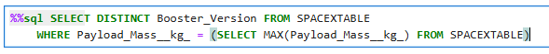
Boosters Carried Maximum Payload
The names of the booster which have carried the maximum payload mass are the following: F9 B5 B1048.4, F9 B5 B1049.4, F9 B5 B1051.3, F9 B5 B1056.4, F9 B5 B1048.5, F9 B5 B1051.4, F9 B5 B1049.5, F9 B5 B1060.2, F9 B5 B1058.3, F9 B5 B1051.6, F9 B5 B1060.3, F9 B5 B1049.7
To obtain this result, it was queried from the SPACEXTABLE dataframe the distinct booster version where the payload mass was the maximum.

Slide 31
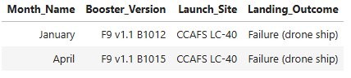
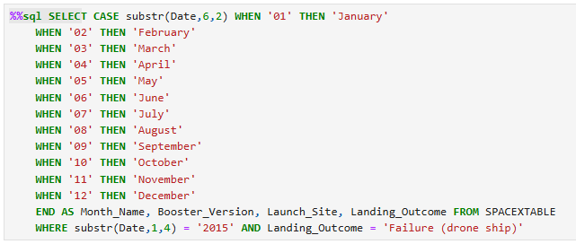
2015 Launch Records
The failed landing outcomes in drone ship, their booster versions, and launch site names in year 2015 were the following:
To obtain this result, first the months had to be selected and their names changed, then it was queried from the SPACEXTABLE dataframe the columns where failed landing outcomes was equal to “Failure (drone ship)” and where the year was 2015.

Slide 32
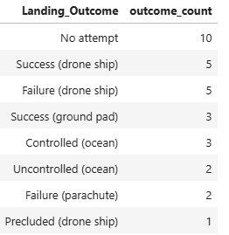
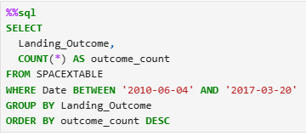
Rank Landing Outcomes Between 2010-06-04 and 2017-03-20
The ranking of the landing outcomes (such as “Failure (drone ship)” or “Success (ground pad)”) between the date 2010-06-04 and 2017-03-20, in descending order, is the following:
To obtain this result, it was queried from the SPACEXTABLE dataframe the number of observations where the date was between 2010-06-04 and 2017-03-20, grouped by landing outcome.

Slide 33

Section 3

Slide 34
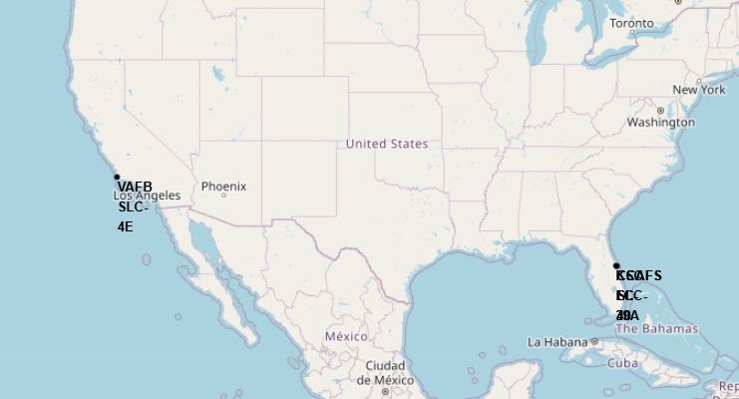
Launch sites of SpaceX
Below are all the launch sites of SpaceX. There are 4 launch sites: CCAFS LC-40, CCAFS SLC-40, KSC LC-39A, and VAFB SLC-4E. The former three are very near each other, so they are “truncated” on the map, in Forida. The later, VAFB SLC-4E, is in California.

Slide 35
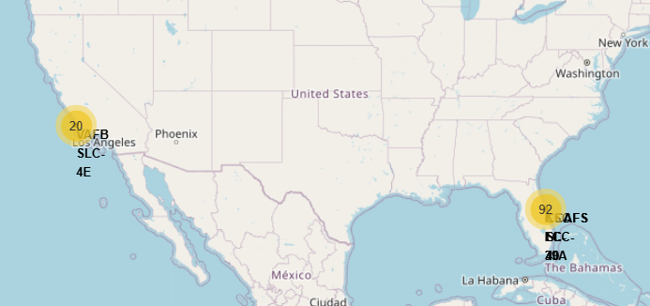
Number of launches per site/region
The map below shows the number of launches at each site. At CCAFS LC-40, CCAFS SLC-40, and KSC LC-39A, there were 92 launches in total (aggregating all three sites), while at VAFB SLC-4E, there were 20.

Slide 36
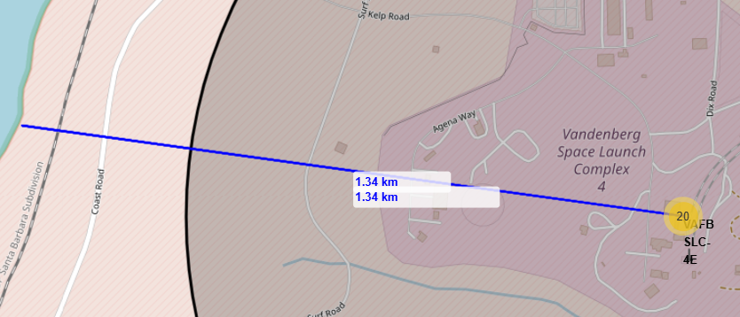
Line between the launch site and the closest coastline
The blue line below indicates the closest distance between the launch site VAFB SLC-4E (in California) and the coastline. As can be seen, the distance is 1.34 km.

Slide 37

Section 5

Slide 38
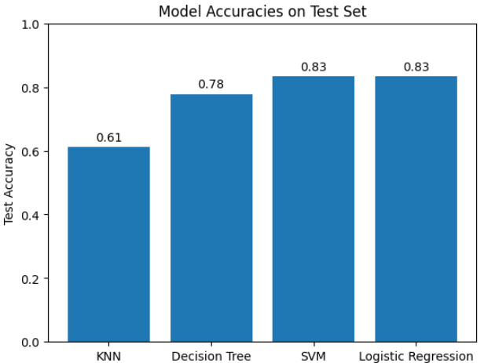
Classification Accuracy
The graph below shows the accuracy of each model constructed. It can be seen that the two most accurate models were SVM and Logistic Regression, with 83% accuracy.

Slide 39
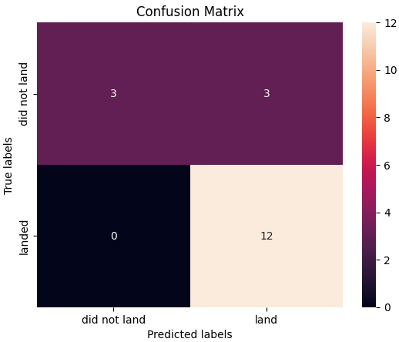
Confusion Matrix
The confusion matrix of the two best models (Logistic Regression and SVM) is show below (both have the same confusion matrix).

Slide 40
Conclusions
Tuned SVM (sigmoid kernel + scaling) and Logistic Regression gave the top test accuracy (~0 .87).
Decision tree was competitive in CV but over-fit, falling to ~0 .72 on test data.
K-NN stayed the weakest (~0 .61) despite exhaustive tuning.
Switching to successive-halving cut search time by ~65 % with no loss in performance.

Slide 41


